Slide 1
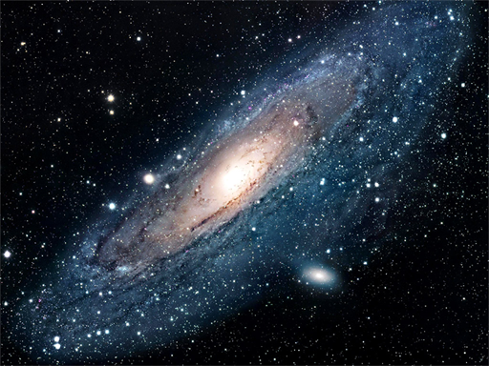


How Far
?
Is Far?

Slide 2
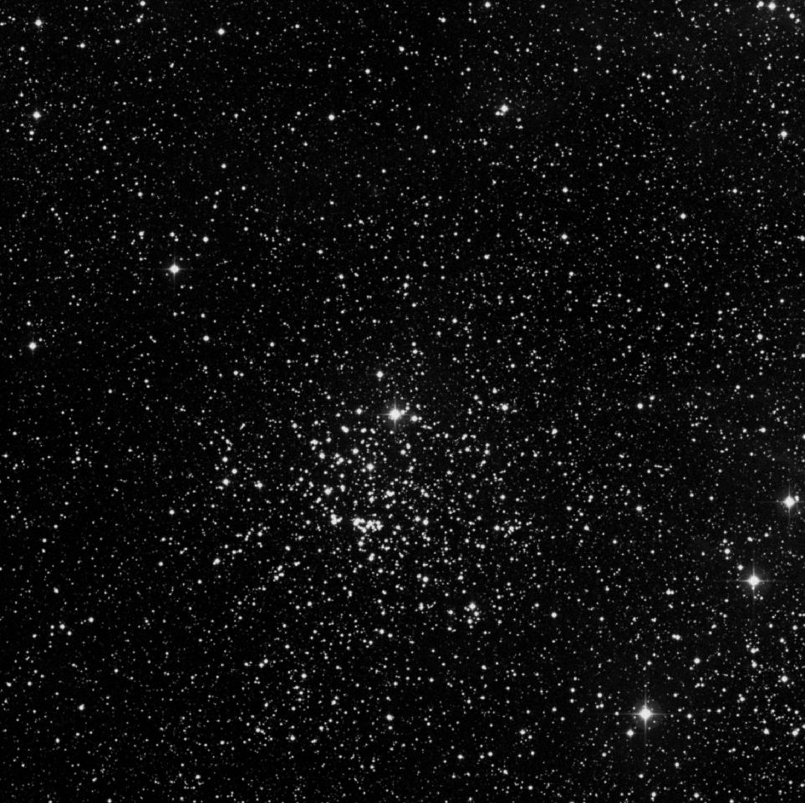
M52 Through the Telescope
Through the telescope, this open cluster of stars will appear as if someone sprinkled salt on a black tablecloth.

Slide 3
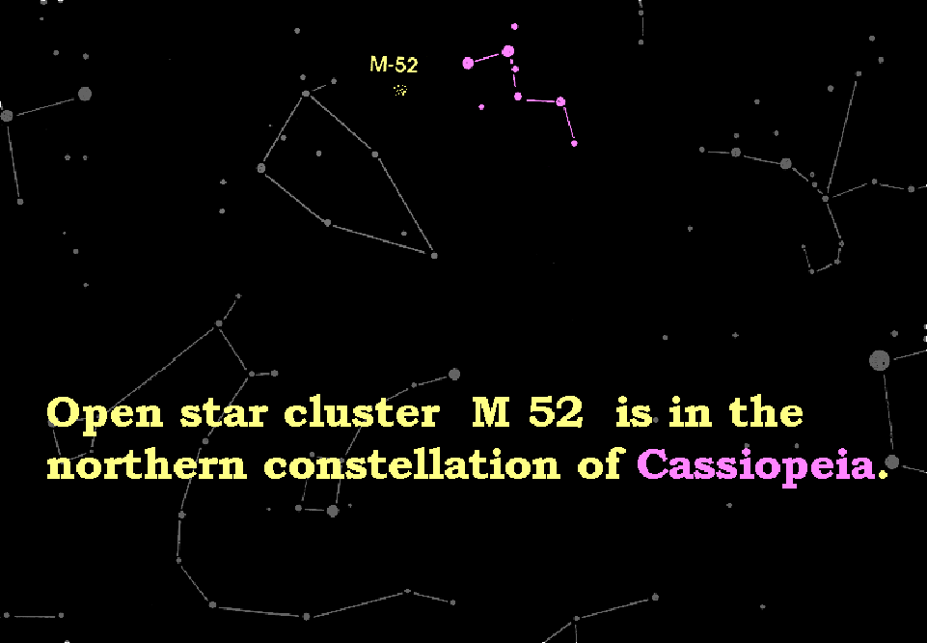
M52 In the Night Sky
Cassiopeia
Cepheus
M52 lies between the constellation Cassiopeia (the queen) and Cepheus (the king)

Slide 4
What is M52?
M52 is an ‘Open Cluster’
It is about 5,200 light years away and contains about 200 stars.

Slide 5
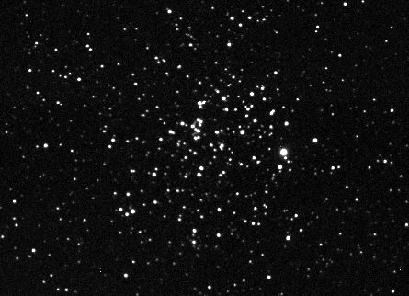
What is an Open Cluster?
An open cluster is a loosely bound group of a few hundred to a few thousand young, newly formed stars.

Slide 6
What is an Open Cluster?
The stars in an open cluster will drift apart after a few hundred million years since they are only loosely bound by their mutual gravity.

Slide 7
What is an Open Cluster?
Star separation in an open cluster increases with age but is typically around 2 light years. Stars in our solar neighborhood are 4-5 light years apart.

Slide 8
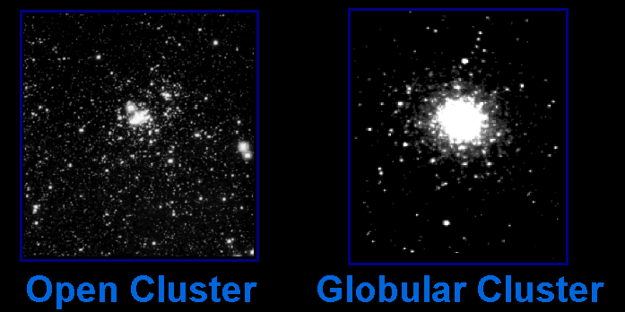
Star Clusters
There are two main types of star clusters in our Milky Way galaxy.

Slide 9
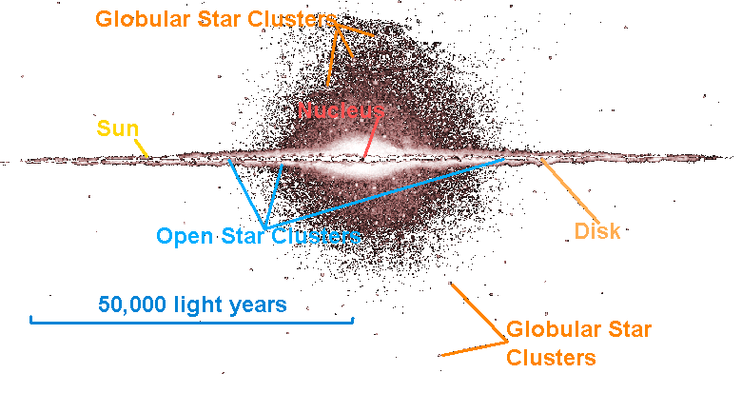
Star Clusters
Star Clusters
Open clusters orbit within the disc of the galaxy while globular clusters orbit above and below the plane of the galaxy.

Slide 10
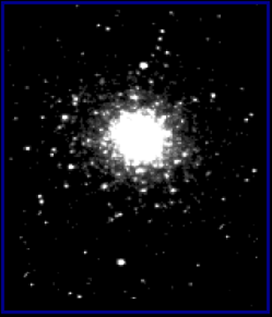

Open and Globular Clusters Are Different
Open clusters are smaller than globular clusters.
Open Clusters
Globular Clusters
about 30 light years across.
about 150 light years across.

Slide 11
Open and Globular Clusters Are Different
Open clusters have fewer stars than open clusters.
Open Clusters
Globular Clusters
have a few thousand stars.
have hundreds of thousands of stars.

Slide 12
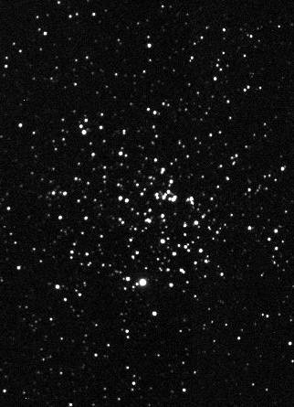
The Distance to M52
M52 lies 5,200 light years away from Earth. In other words, it takes light 5,200 years to get from M52 to Earth. Light travels about 6 trillion miles per year!
5,200 light years
So how do we measure these vast distances?

Slide 13
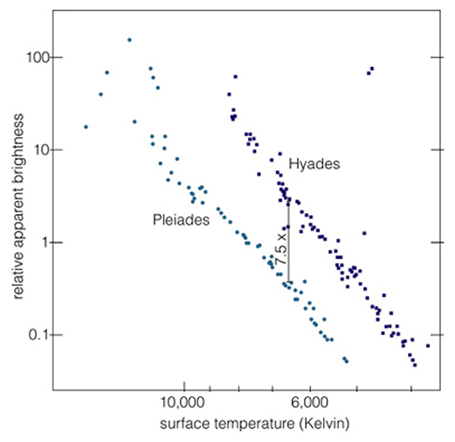
Distances to Open Clusters
The great distances to open clusters are usually determined by using a method called Main Sequence Fitting.

Slide 14
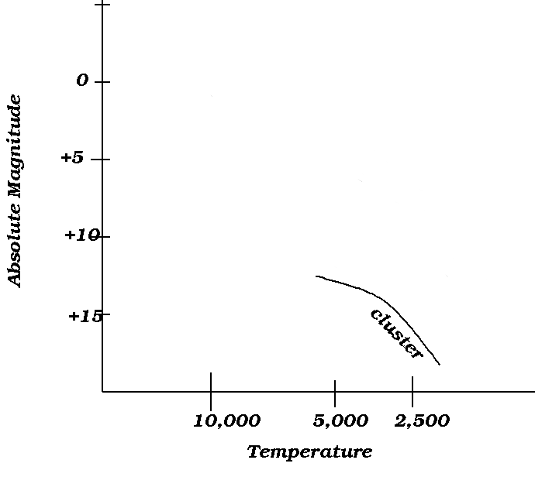
Main Sequence Fitting
First, a plot of surface temperature vs. absolute magnitude is made of all the stars in the cluster.

Slide 15
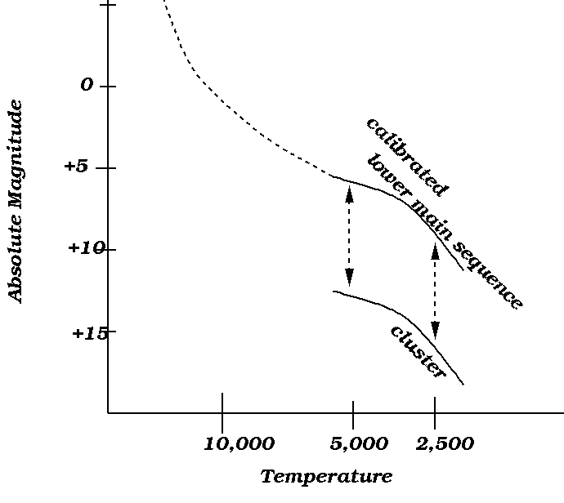
Main Sequence Fitting
That plot is then compared to a calibrated plot of temp vs. magnitude of a group of stars whose distances are known from parallax measurements.

Slide 16
Main Sequence Fitting
The difference in brightness is due to distance which can, therefore be calculated using the distance modulus.

